Slide 1
African Heritage Season
www.amraproductions.com
AFRICAN ARTS WORKSHOPS 4 SCHOOLS, COLLEGES AND UNIVERSITIES
Call or email now for bookings
Tel: Tel: 07402 953987
E: amraproductions@gmail.com
Black history month – modern and ancient visions of AFRICA and the African Diaspora

Slide 2
OCTOBER
Black History has been celebrated across the UK for many years, each year growing from strength to strength. BLACK HISTORY MONTH or preferred term AFRICAN HERITAGE MONTH is a time when schools highlight and celebrate the achievements of African people and African culture in our communities.
This year AMRA will be offering a fabulous collection of expressive arts workshops aimed at children and young people of all ages. Amra’s celebration of African arts and cultural awareness is an exploration into African and Caribbean performing arts, utilizing a vast range of African art forms such as DRUMMING, SONG, DANCE and every more popular STORYTELLING.

Slide 3
AIMS & OBJECTIVES
Call or email now for bookings
Tel: 07402 953987
E: amraproductions@gmail.com
www.amraproductions.com
To explore the historical, contemporary, cultural, geographical and social importance of music, dance, theatre arts and its value, significance in modern day. These productions will enable the participant to gain an insight into the history, traditional and modern culture and a knowledge of the general context of the arts in the African Continent and practical experience of these art forms.
We value the local element of our work, with the effect of increasing awareness and access across all boundaries

Slide 4
Artistic Director Angie Amra Anderson BA Hons
Over 40 years
Pioneering African Arts in the UK
The inspiration and guiding force for this project is Angie Amra Anderson BA Hons. Trained at the SOAS (School of Oriental & African Studies) she has acquired a vast performing experience and is one of the UK’s top African arts practitioners.
In 1976. she co-founded the award-winning Ekome National Dance Company, which took England and Europe by storm for over a decade. She has been an invited guest/teacher/performer in Europe, Scandinavia, Jamaica, Haiti, Ghana and Nigeria and she is known to thousands of students as a very charismatic teacher and has created a stimulating way of communicating this rich and diverse art form.
Her research in African Caribbean and especially African-Cuban art forms left a tremendous emotional and aesthetic experience. As a principal dancer with numerous dance companies, her work gained a new strength and authority from it. Her TV & Film appearances includes The South Bank Show, Highway, A Sailor’s Return, Bacchanal, Ebony, Only Fools & Horses and for BBC Education Music Makers among others.
Her innumerable records of performances have been with artistes such as Peter Gabriel, Franco, Osibisa and Fela Kuti to name a few. 2016, she continues to receive many accolades including Cultural Ambassador of the Year and Lifetime Achievement Award for Contribution to African Arts
Angie Amra Anderson
Received the 2016 Lifetime Achievement for Contribution to African Arts in the UK

Slide 5
AMRA’S COMBINED ARTS WORKSHOP (Drumming, Dance & Song)
An introduction into African and Caribbean art forms, which includes a performance style demonstration, yet incorporates a workshop within the structure.
The session begins with a 15 minutes presentation; proceeded by a session in African dance, drum language and African drumming.
All workshops culminated into a performance/sharing by all participants.
Call or email now
for bookings
Tel: 07402 953987
amraproductions@gmail.com

Slide 6
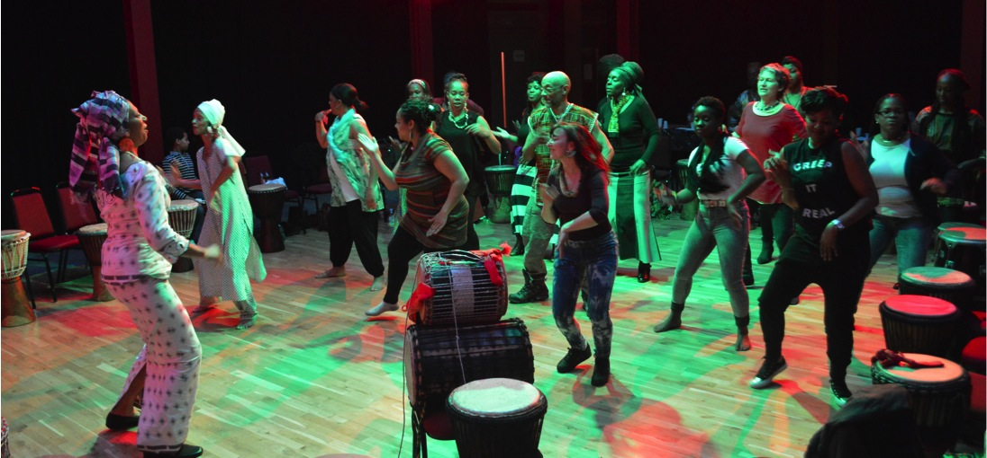
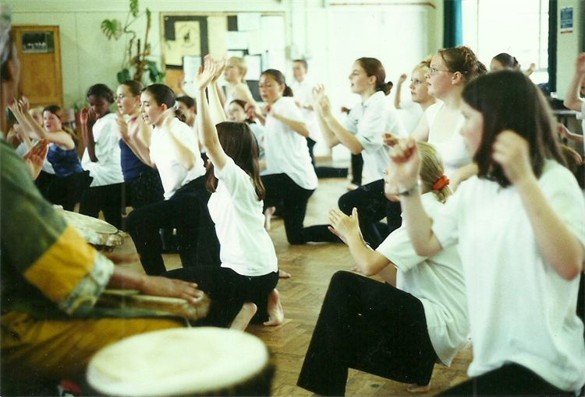
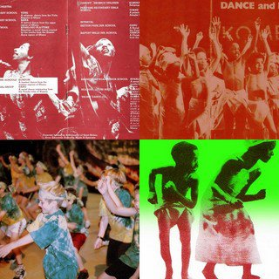
AFRICAN DANCE WORKSHOPS
The substance of the teaching program is the traditional dances of Africa and the Caribbean. The dances are energetic, graceful and enormously expressive. Each dance has a definite theme and represents an aspect of African life; courtship, initiation into adulthood, trading, war – to name a few.
The movements of the dances are determined by the rhythm of the drum and thus participation increases musical as well as movement skills. Through gaining competence in the art form students also increases their CONCENTRATION, COORDINATION, STRENGTH, FLEXIBILITY, GRACE, RHYTHM SENSE and ACHIEVE MENTAL and PHYSICAL SELF-DISCIPLINE

Slide 7
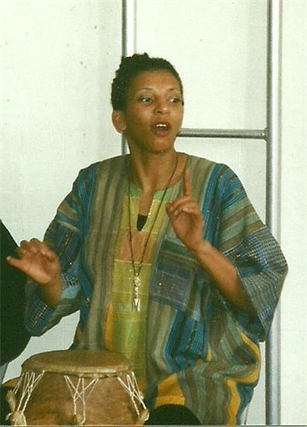
STORYTELLING with drumming and participation
These workshops draws heavily from folk tales from Africa and the Caribbean. Comparisons will be made with popular folk traditions, exploring themes, subjects and morals.
By the end of the workshops, participants would have learnt about the adventures, intrigues and similarities between them and the characters.
These workshops trace the social environmental roots of various tales within the context of the culture from which they originate.
These workshops should not be missed by those interested in enriching their vocabulary and therefore language by using the repositories of ancient and contemporary wisdom.
All workshops are
designed to cater for all people for all ages, in schools, colleges, and bespoke events

Slide 8
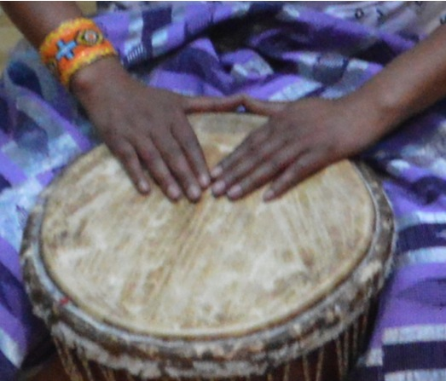
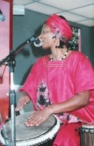
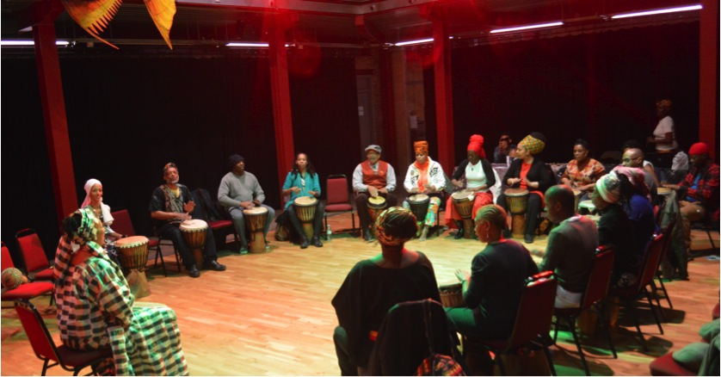
AFRICAN DRUMMING
The substance of the drumming program is West African music produced by an orchestra of drums to complement the dances referred to above as well as pieces, which exist independently as musical statements.
Caribbean drumming which has its origin in Africa is also taught
The complex rhythms are controlled by the master drum, which ‘speaks’ in a unique drum language, which once learnt can be used to learn new pieces quickly
For this reason, as well as their own inherent power, children and young adults find the rhythms particularly compelling, and the program thus imparts a strong basis of rhythm sense, as well as the qualities of strength, coordination and cooperation.
Drum language is an oral, rather than written tradition and as such have proved to be effective with students who balked at the complexities of notated music

Slide 9
BOOKING AND FEES CONTACT: ANGIE AMRA ANDERSON TEL 07402 953 987 E: amraproductions@gmail.com www.amraproductions.com
FULL DAY (Up to 5 workshops)
£400 which can include a short presentation by all participants at the end
HALF DAY (up to 3 workshops)
£295
ONE WORKSHOP 1 HOUR £140
ASSEMBLY DEMONSTRATIONS £95
INSETS FOR TEACHERS
£350 PER DAY

Slide 10
African Heritage Season
www.amraproductions.com
AFRICAN ARTS WORKSHOPS 4 SCHOOLS, COLLEGES AND UNIVERSITIES
Call or email now for bookings
Tel: Tel: 07402 953987
E: amraproductions@gmail.com
Black history month – modern and ancient visions of AFRICA and the African Diaspora

